Slide 1

ESG ratings vs Stock Performance
Project Check-In
Maria Vitullo, Amira Eid

Slide 2

Added more data ( s&P 500 financials)
After the initial project proposal, the main feedback was to increase the number of rows to aid in the machine learning portion of the project. That is why I decided to scrape Wikipedia for the ticker symbols of stocks in the S&P 500. After that, I could loop through those tickers and collect financial markers from Yahoo Finance. I couldn’t get the same financial ratios, but they are similar.
Here is a link to the new data dictionary

Slide 3
Research Question 1: To what extent does a high ESG rating correlate with economic performance?
Look at our merged data frame, we have lots of different features to work with to see companies’ economic performance and run tests to see if there is any correlation.
Some columns that could reflect economic or financial performance would be P/E ratio, Forward P/E, Revenue (TTM), Gross Profits, Net Income, EBITDA, and Market Cap
First we started with some univariate testing where we gained a better perspective on the data
Then we tested the correlation between each feature and the target ( this revealed low correlations)
Lastly we created a random forest model to display feature importance chart

Slide 4
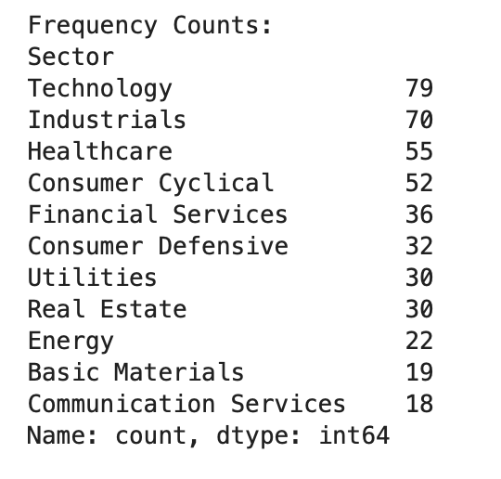
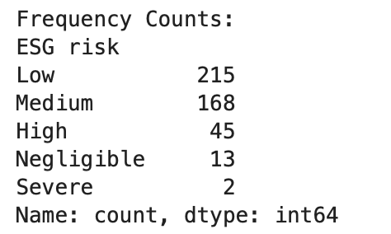
Univariate Testing
We wanted to get a better understanding of the data that we are working with. What is the revenue dist., how even is the distribution of sectors, and what is the number of companies in each risk category? After our univariate testing we uncovered 3 main findings.
There is a pretty even distribution of sectors that the companies fall into. However, technology, industrials, and healthcare dominate
There are about 35 – 40 companies whose revenues are much larger than the remaining S&P 500
Lastly, our data includes mostly LOW and MEDIUM risk ESG companies. Additionally, we only have two rows where the ESG risk is severe. This may impact the analysis down the line.

Slide 5
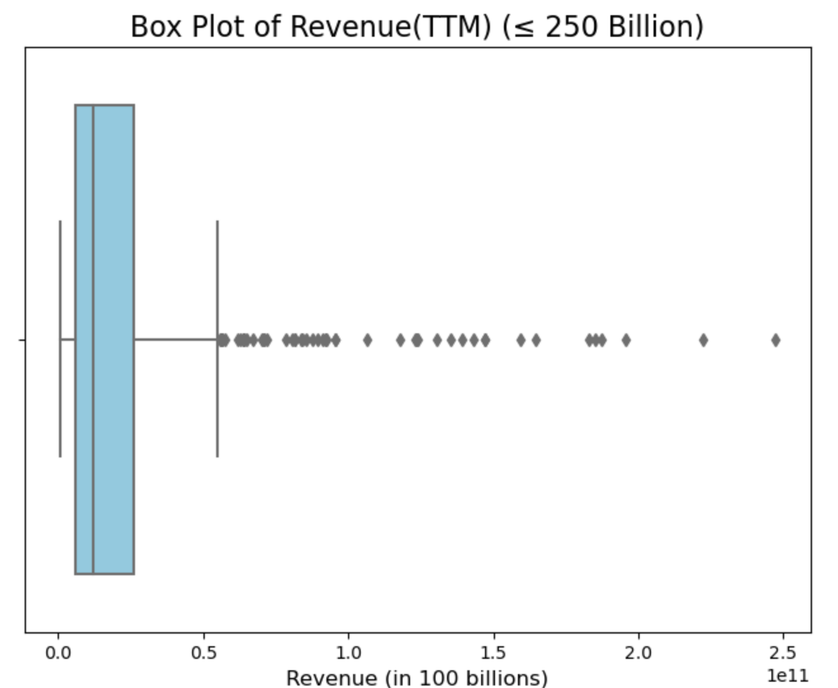
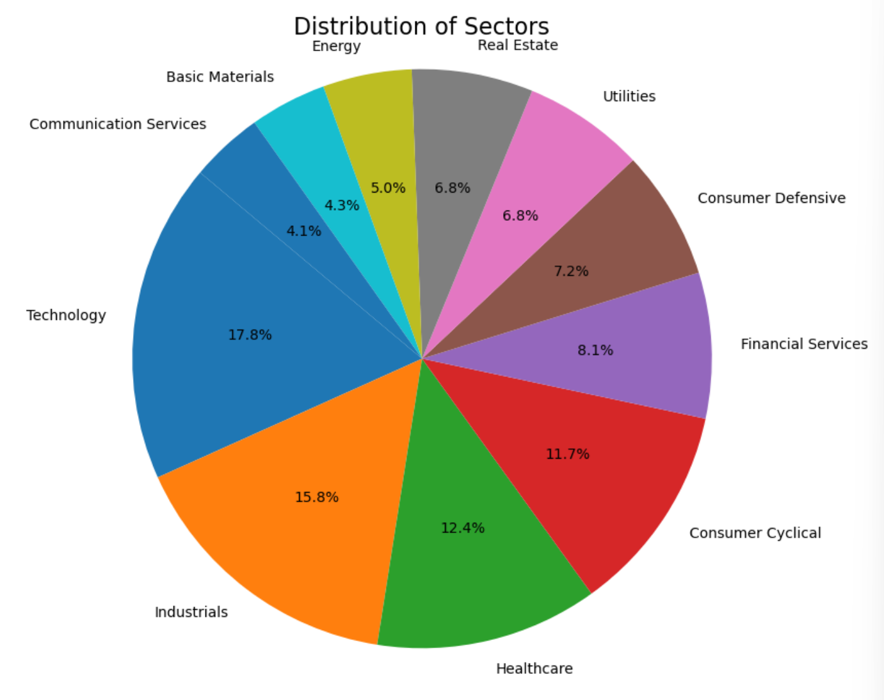
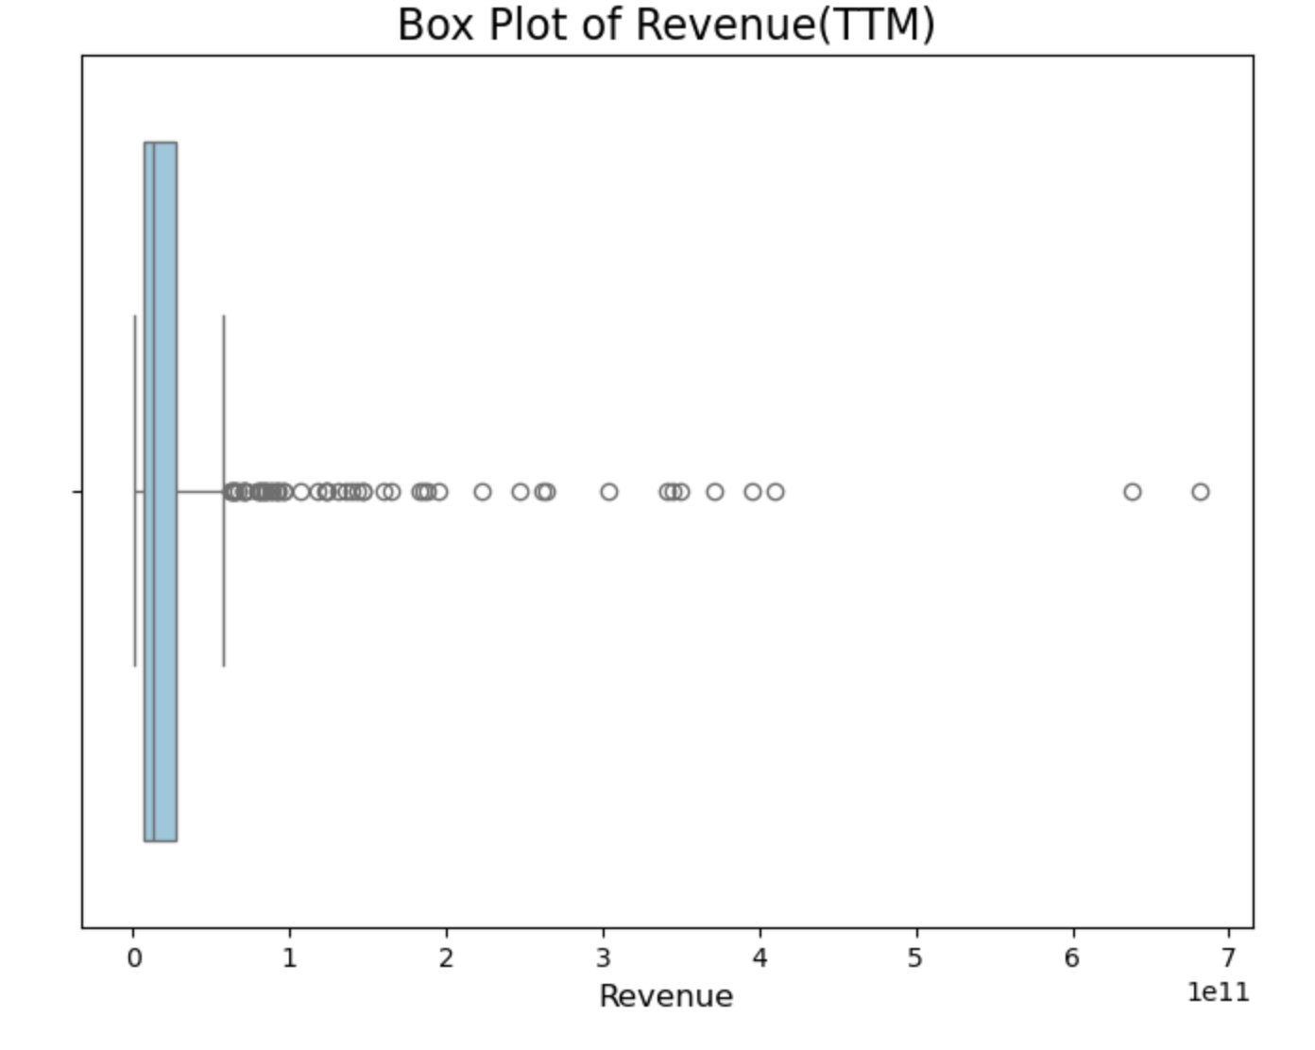
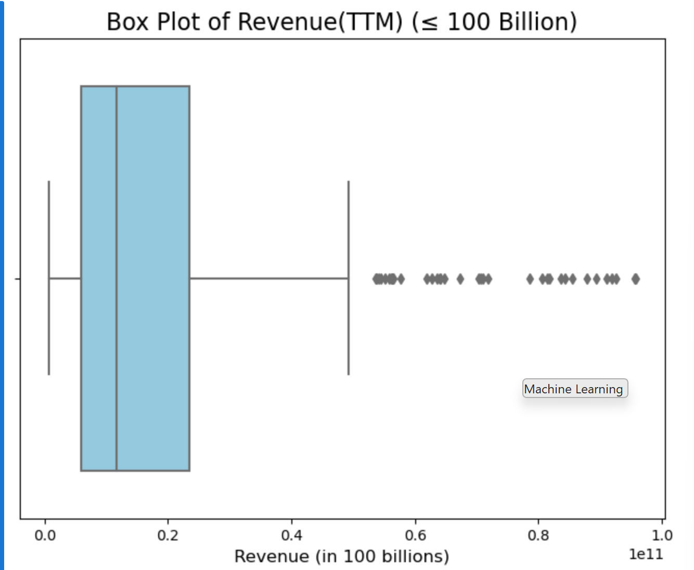
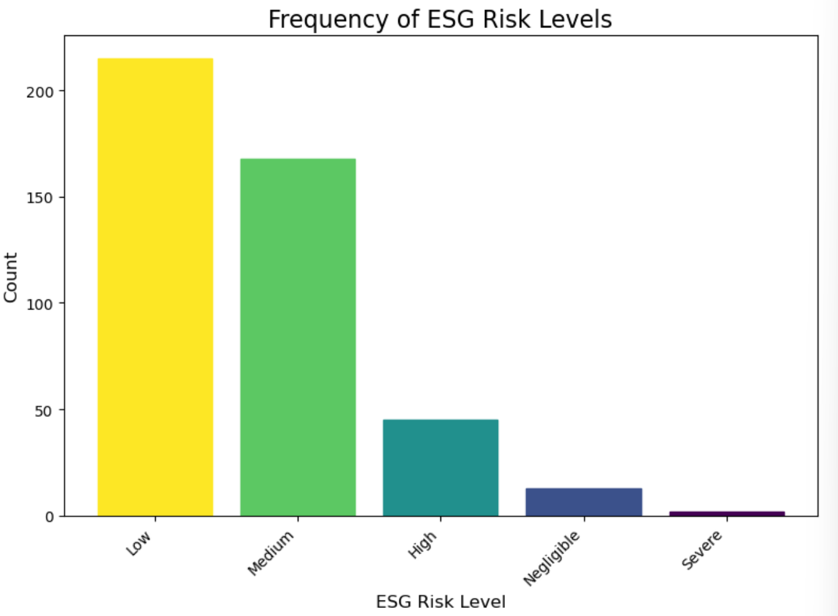
UNIVARIATE VISUALIZATIONS

Slide 6

Bivariate Testing
We chose to do Spearman correlation testing since our data was not normally distributed
Most of our variables are continuous, so correlation testing was optimal
We looked at the correlation between Net Income and ESG Score, Revenue and ESG score, Market Capitalization and ESG Risk (turned into numeric categories), and P/E Ratio and ESG score
Each correlation outcome revealed a weak correlation and was not enough to show that one economic performance variable correlated with ESG score or risk

Slide 7
Hypothesis Test
H₀ (null hypothesis): Financial ratios like P/E Ratio, Revenue, and Net Income have no association with ESG Risk level
H₁ (alternative hypothesis): Stronger financial ratios (like higher Net Income or lower P/E Ratio) are associated with lower ESG Risk.

Slide 8
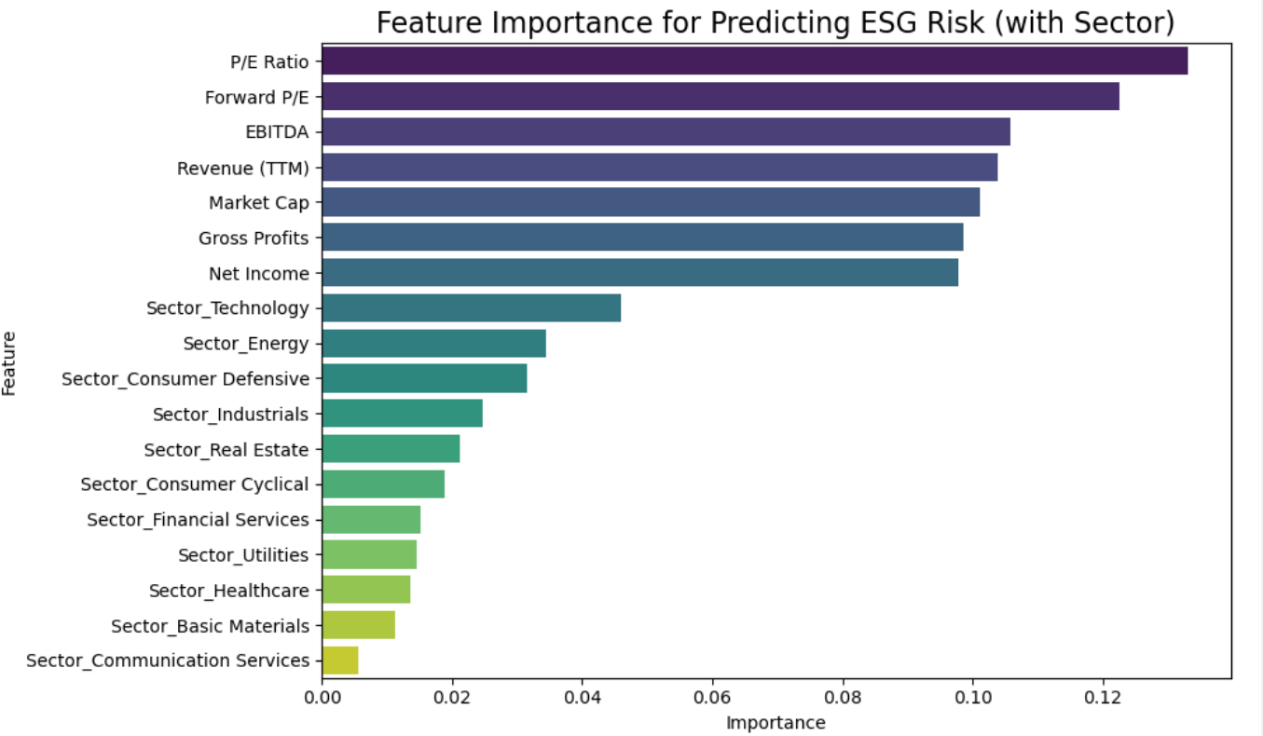
Machine Learning (Python Steps)
Selected key financial features (P/E Ratio, Revenue, Net Income, EBITA, Market Cap Gross Profit, Forward P/E.) One-hot encoded Sector (turned categories into numbers)
Train-Test Split 80% Training set, 20% Testing set
Handling Class Imbalance by testing class_weight='balanced' in the Random Forest model
Trained a Random Forest Classifier with 500 trees
6. Overall found P/E Ratio, Forward P/E, and EBITDA were the most important predictors (Sector contributed, but financial metrics were stronger)
Measured accuracy on the testing data Focused on improving prediction for all ESG Risk categories.(The highest accuracy achieved was .51)

Slide 9
Challenges | Questions
Our data only has 2 rows of “Severe” esg risk, and 13 negligible. The uneven dist. of that may be affecting our model. Our data also only includes the largest 500 companies in the stock market. Maybe this scope is not the most optimal for the analysis we are doing There doesn’t seem to be statistical significance linking any one financial ratio/data to esg score, risk, or category. 36 outliers in terms of “revenue” may also be impacting our analysis | How can we set up our linear regression in a more optimal way? Is there a chance that the lack of data in certain ESG categories is messing up our analysis? Could the finding that there isn’t statistical significance in the correlations between financial information and company information be important.

Slide 10
Road Map
For Research Question 1, we will group companies by sector and calculate the average ESG score for each sector. We will visualize the results using bar charts and box plots to explore which industries are most impacted by ESG factors. We also plan to perform an ANOVA test to determine if the differences between industries are statistically significant.
For Research Question 2, we will categorize companies by ESG Risk level (Negligible, Low, Medium, Severe) and summarize key financial ratios (P/E Ratio, Revenue, Net Income, etc.) across groups.This will hopefully remove the issue of uneven distributions in risk level. We will use box plots and bar charts to visualize differences and apply ANOVA tests to identify which financial metrics vary most significantly with ESG performance.
For the Machine Learning model, we will prepare the data by selecting financial features and encoding sector information. After handling missing values, we will train a Random Forest Classifier with 500 trees. We will evaluate model accuracy and analyze feature importance to identify which financial metrics are most predictive of ESG Risk.

